Slide 1



SHADAN WOMEN'S COLLEGE OF ENGINEERING AND TECHNOLOGY
[ An UGC Autonomous Institution Affiliated to JNTUH ]
Topic : Smart Job Portal-Real Time Job Search
And AI Recommendations
Real-Time Research Project - Review 2
Presented By : Amath ur Rasheed U.A. (24L51A0508)
Supervisor : Ms. Sadaf Jahan
Class : B.Tech 2nd Year 2nd Semester
Section : CSE-A

Slide 2


ABSTRACT
Finding suitable job opportunities can be difficult because traditional job portals require users to manually search through many listings that may not match their skills and qualifications. This process is often time-consuming and inefficient. The proposed Smart Job Portal with Real-Time Job Search and AI Recommendation aims to improve the job search experience by providing the latest job postings in real time and recommending relevant jobs based on users’ profiles, skills, and preferences using Artificial Intelligence (AI). This system helps job seekers quickly find suitable job opportunities while enabling employers to reach the right candidates. The main goal of this project is to make the job search process faster, more accurate, and more user-friendly.

Slide 3

A Smart Job Portal with Real-Time Job Search and Al Recommendation is an advanced online platform designed to help job seekers find suitable employment opportunities quickly and efficiently. It combines real-time job updates with Artificial Intelligence (AI technology to provide personalized job recommendations based on a user's skills, qualifications, and preferences. This topie is important because the traditional job search process is often time-consuming and inefficient. requiring candidates to manually browse through many job listings that may not match their profiles. Overall, this system aims to create a more intelligent, user-friendly, and efficient platform that helps individuals find suitable career opportunities while assisting organizations in selecting the right talent.
Introduction

Slide 4
Existing System
  Job seekers search for jobs manually on different job websites.
  Users must visit multiple portals to find suitable job opportunities.
  Most systems provide only basic job listings without smart suggestions.
  There is no AI-based recommendation system to match jobs with user skills.
  Job searching process is time-consuming and less efficient.
  Many platforms do not provide real-time updates of job postings.

Slide 5

Existing System with Disadvantages
  Time-consuming process for job seekers to find suitable jobs.
  Sometimes job information is not updated in real time.
  Users need to visit multiple job portals to find opportunities.
MISSING LATEST JOB UPDATES
  Job results may not be personalized for each user.

Slide 6
Proposed System- AI-Driven EcoSystem
Intelligent Semantic Matching
Moves beyond keyword matching to understand the context of skills (e.g., recognizing that "MERN Stack" implies proficiency in React and Node.js).
Real-Time Data Streaming
Uses WebSockets to push new job listings to users instantly, eliminating the need for page refreshers.
​Automated Skill-Gap Visualization
Provides users with a "Match Score" and identifies specific skills they need to learn to qualify for a role.
​ Vectorized Profile Analysis
Converts resumes into mathematical vectors to compare them against job descriptions with high precision.

Slide 7

Advantages Over Existing Ecosystem
Reduced Time-to-Hire : Recruiters see the most qualified candidates at the top of their list instantly, ranked by AI accuracy.
Elimination of "Keyword Stuffing": The AI focuses on the quality and depth of experience rather than how many times a word appears in a resume.
High Engagement : Real-time notifications ensure users never miss an opportunity, leading to faster application cycles.
Data-Driven Career Guidance : Unlike traditional boards, this system acts as a career advisor by suggesting relevant job pivots based on transferable skills.

Slide 8
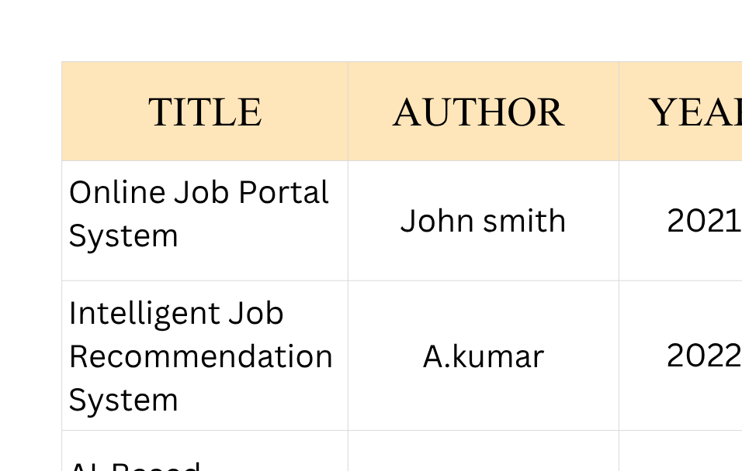
Literature Survey- Market Analysis

Slide 9
Algorithms
Step 1
Step 2
Text Pre-processing
Resumes and Job Descriptions are cleaned and tokenized into individual skill units.
Vectorization (TF-IDF)
The system converts words into numerical values based on their importance and frequency in the industry.
Step 3
Step 4
Cosine Similarity Calculation
The algorithm measures the "angle" between the User Vector and the Job Vector to determine how closely they align.
Score Generation
The result is normalized into a percentage (0-100%) and displayed as the "Smart Match Score".
Step 1

Slide 10
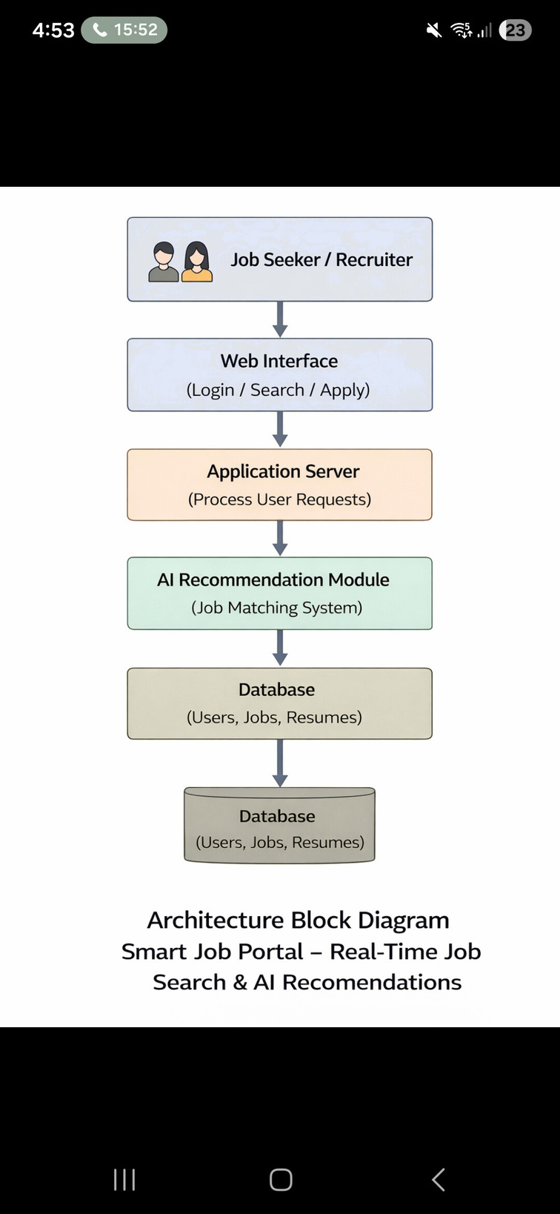
Architecture
  User Interface :
Job seekers and recruiters interact with the system through a web or mobile interface.
  User Authentication Module :
Handles user registration and login for secure access.
  Application Server :
Processes user requests such as job search, job posting, and applications.
  AI Recommendation Module :
Analyzes user profile, skills, and interests to recommend suitable jobs.
  Database Management System :
Stores user details, job postings, resumes, and application records.

Slide 11

Methodologies
Used
AI-Based Recommendation Method
The system uses Artificial Intelligence to analyze user profiles, skills, and job preferences. Based on this analysis, the system recommends suitable job opportunities to the users. This method improves the accuracy of job matching.
Agile Methodology
The project follows the Agile methodology, where the development process is divided into small stages called iterations. Each stage focuses on developing and improving specific features of the system. This approach helps in continuous improvement, faster development, and easy modification based on user feedback.

Slide 12

MODULES
Used
User Registration and Login Module
Job Search Module
This module helps users search for jobs using filters such as job role, location, and qualification. It allows users to easily browse and find available job opportunities.
This module allows users to create an account, log in to the system, and manage their profiles. Job seekers can upload their resumes and provide details such as skills, education, and experience

Slide 13
Application Management
Module
AI Recommendation
Module
Job Posting
Module
This module manages the entire job application process. It allows job seekers to apply for jobs directly through the portal by submitting their resumes and details. Employers can view the list of applicants and select suitable candidates for further steps such as interviews.
This module analyzes the user’s profile, including skills, qualifications, experience, and preferences. Based on this information, the system suggests jobs that best match the user’s profile. This helps users quickly find relevant job opportunities
This module allows employers or recruiters to post job vacancies on the portal. Employers can add details such as job title, job description, required skills, qualifications, experience, and job location. It helps organizations reach a large number of job seekers through the platform.

Slide 14

UML DIAGRAMS
UML (Unified Modeling Language) is a standard graphical language used to design and represent a software system. It helps in understanding the structure, workflow, and interaction of different modules in a project. In the Job Portal System, UML diagrams are used to explain system functionality clearly and effectively.
In the Job Portal System, UML diagrams such as Use Case, Class, Sequence, Collaboration, Activity, Component, and Deployment diagrams are used to explain user interactions, system modules, workflow, and architecture. These diagrams help in proper planning, development, testing, and maintenance of the system, making the project easier to understand and implement.

Slide 15
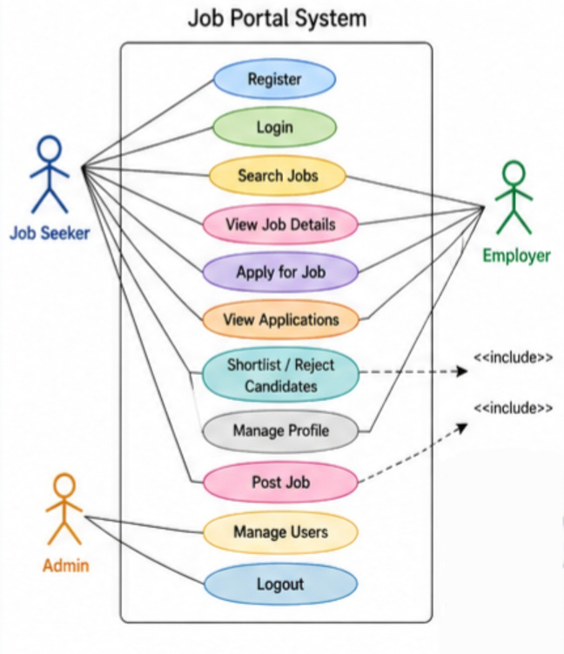
USE CASE DIAGRAM
  Use Case Diagram shows the interaction between users and the Job Portal System.
  Main actors in the diagram are Job Seeker, Employer, and Admin.
  Diagram represents functions such as login, registration, apply job, and post job.
  Use Case Diagram helps in identifying system requirements clearly.
  Diagram is useful for understanding user roles and services.

Slide 16
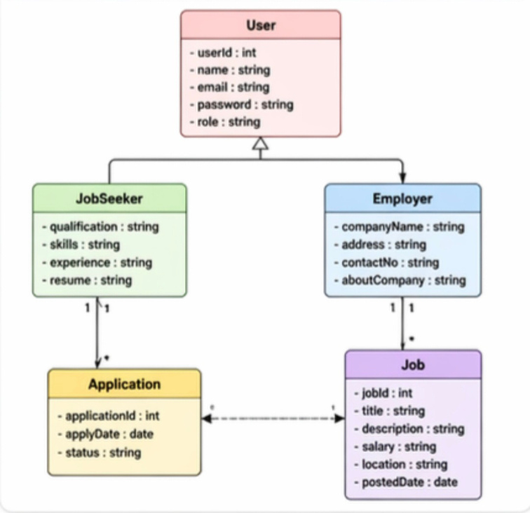
CLASS DIAGRAM
  Class Diagram shows the classes, attributes, methods, and relationships in the system.
  Main classes in the project are User, JobSeeker, Employer, Job, and Application.
  Diagram represents the static structure of the Job Portal System.
  Class Diagram helps in object-oriented system design.
  Diagram is useful for coding and database planning.

Slide 17
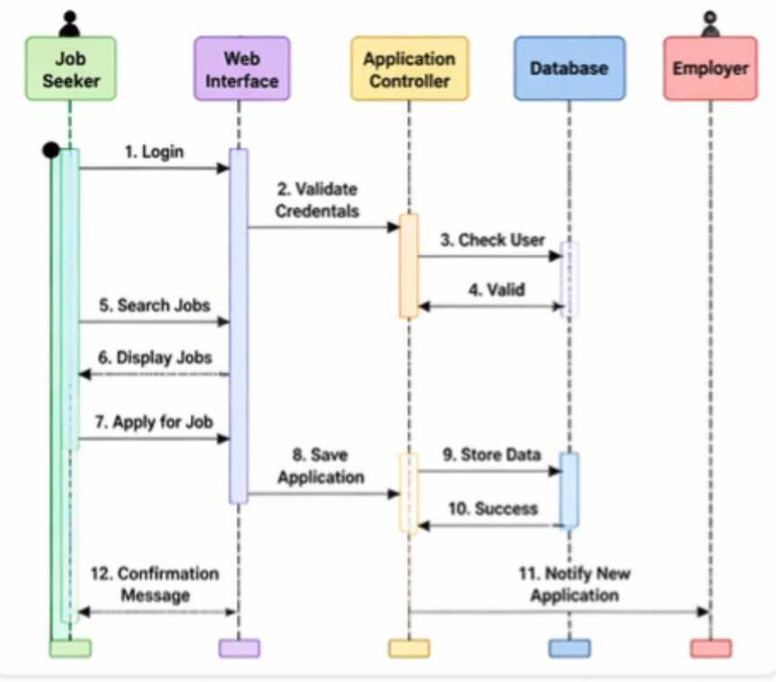
SEQUENCE DIAGRAM
  Sequence Diagram shows the step-by-step interaction between objects over time.
  Diagram explains processes such as login and applying for jobs.
  Sequence Diagram represents message flow between user and system components.
  Diagram helps in understanding the execution order of processes.
  Sequence Diagram is useful for analyzing dynamic behavior.

Slide 18
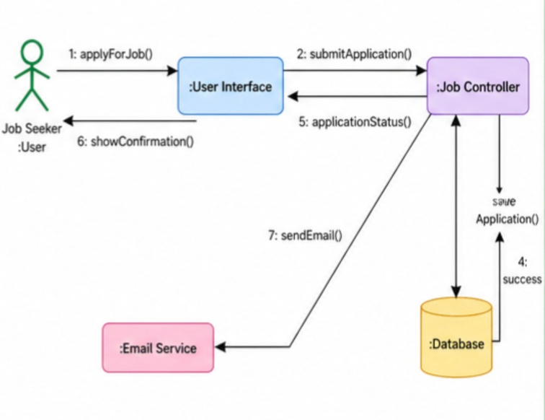
COLLABORATION DIAGRAM
  Collaboration Diagram shows communication between different objects in the system.
  Diagram focuses on message exchange among modules.
  Main objects include user interface, controller, and database.
  Collaboration Diagram helps in understanding coordination between components.
  Diagram is useful for process interaction design.

Slide 19
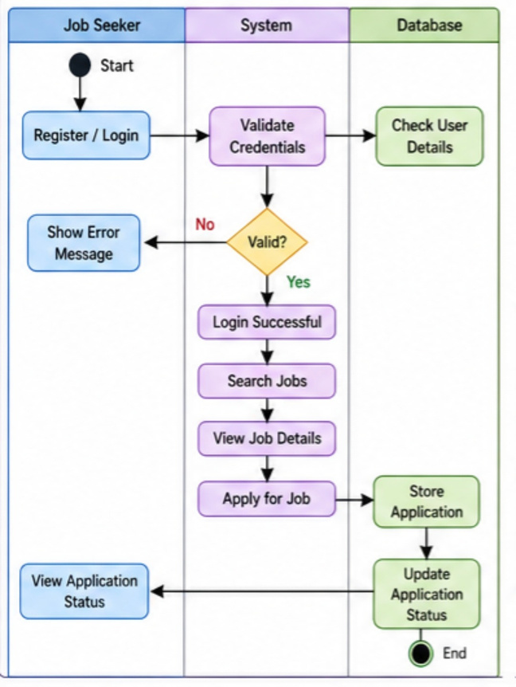
ACTIVITY DIAGRAM
  Activity Diagram represents the workflow of activities in the system.
  Diagram shows steps such as registration, login, and job search.
  Activity Diagram includes decision points and control flow.
  Diagram helps in understanding complete business processes.
  Activity Diagram is useful for logic and flow planning.

Slide 20
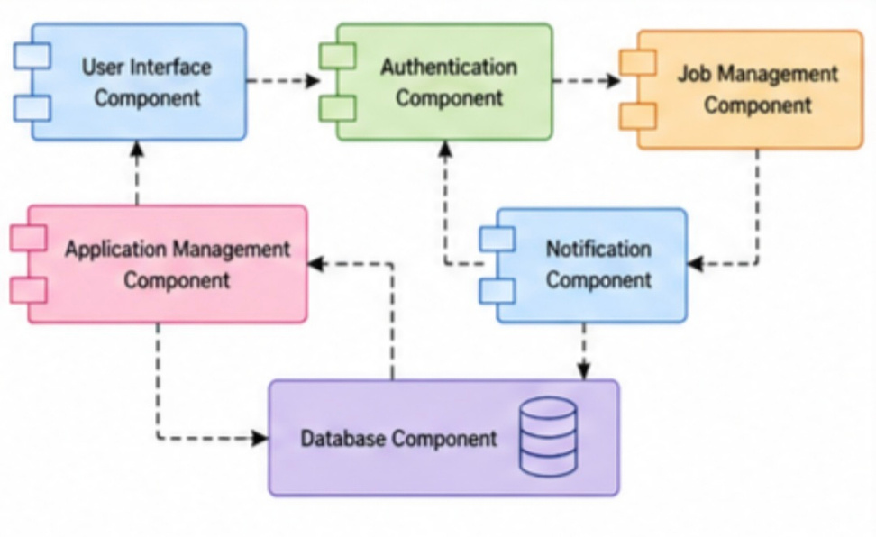
COMPONENT DIAGRAM
  Component Diagram shows the major software modules of the system.
  Diagram includes frontend, backend, database, and authentication modules.
  Component Diagram represents dependency between system components.
  Diagram helps in understanding modular system design.
  Component Diagram is useful for software architecture planning.

Slide 21
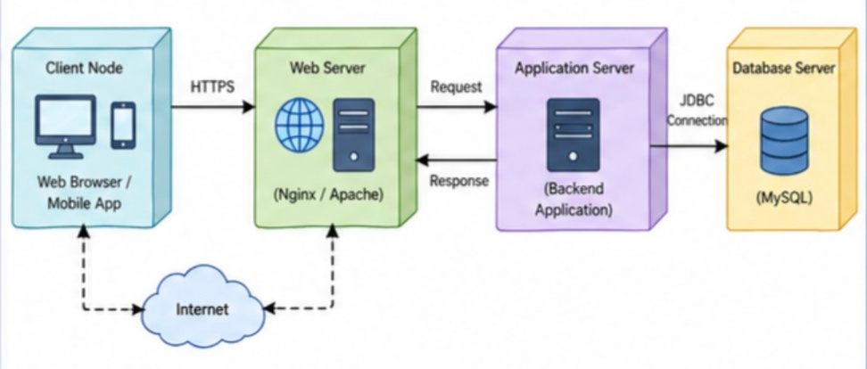
DEPLOYMENT DIAGRAM
  Deployment Diagram shows the hardware and network structure of the system.
  Diagram includes client devices, web server, and database server.
  Deployment Diagram represents the installation and execution environment.
  Diagram helps in understanding system connectivity.
  Deployment Diagram is useful for deployment planning.

Slide 22
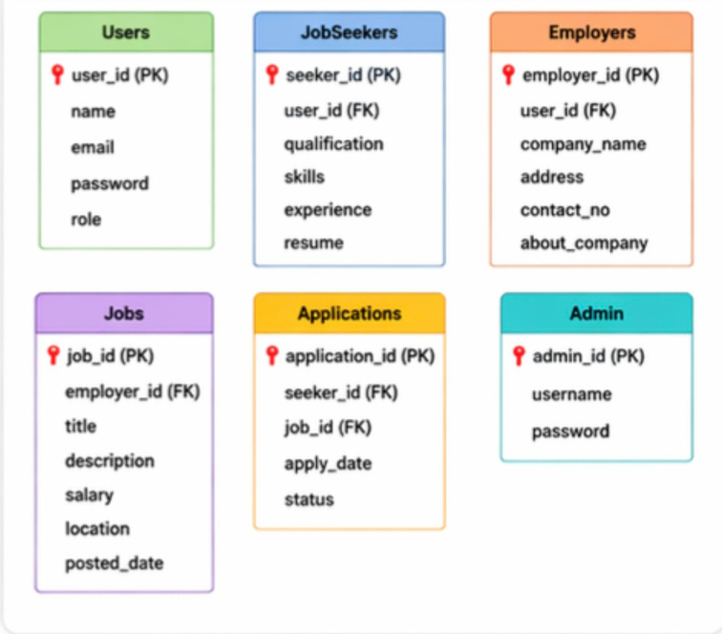
DATABASE DESIGN (TABLES)
  Database Design defines the structure of data stored in the Job Portal System.
  Main tables used in the project are Users, JobSeekers, Employers, Jobs, Applications, and Admin.
  Users table stores login details such as name, email, password, and role.
  Jobs table stores job title, description, salary, location, and company details.
  Applications table stores candidate job applications and status information.

Slide 23
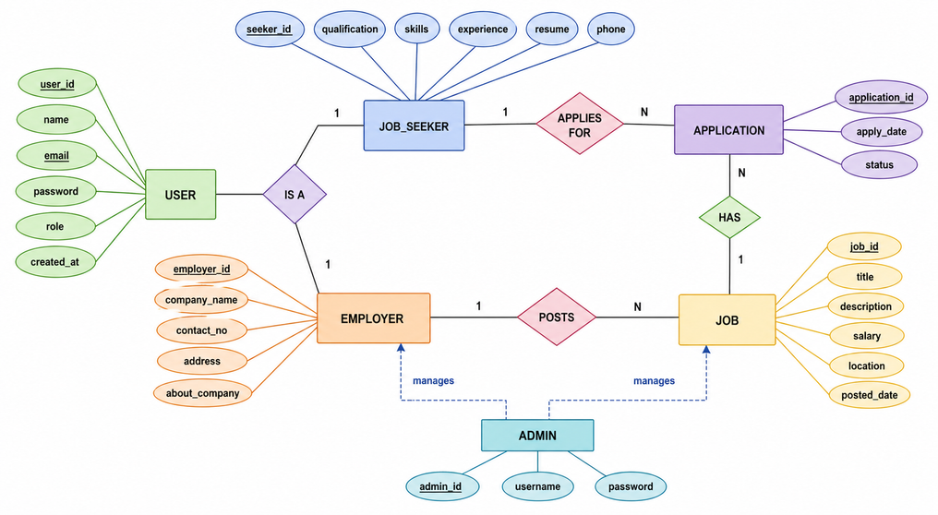
E-R DIAGRAM
  E-R Diagram represents entities and relationships in the Job Portal database.
  Main entities are User, JobSeeker, Employer, Job, and Application.
  Employers can post many jobs, and job seekers can apply for many jobs.
  Each application is linked with one candidate and one job.
  E-R Diagram helps in designing a structured and normalized database system.

Slide 24
TESTING
Testing is the process of checking whether the Job Portal System works correctly and satisfies user requirements. It helps in identifying errors, improving quality, and ensuring smooth system performance.
Objectives of Testing :
  To identify and remove errors in the software.
  To verify whether the system meets user requirements.
  To check the accuracy of outputs for given inputs.
  To improve software performance and reliability.
  To ensure data security and privacy.
  To validate smooth integration of modules.
  To make the system user-friendly and efficient.
  To ensure readiness of the software for deployment.

Slide 25
UNIT TESTING :
Unit Testing is performed on individual modules separately. It checks modules such as login, registration, job posting, and job search independently. It helps in early detection of coding errors.
INTEGRATION TESTING :
Integration Testing verifies whether combined modules work correctly together. It checks communication between modules such as login with dashboard, job posting with database, and applications with employer panel.
SYSTEM TESTING :
System Testing is performed on the complete Job Portal System as a whole. It ensures that all modules work together according to requirements.

Slide 26
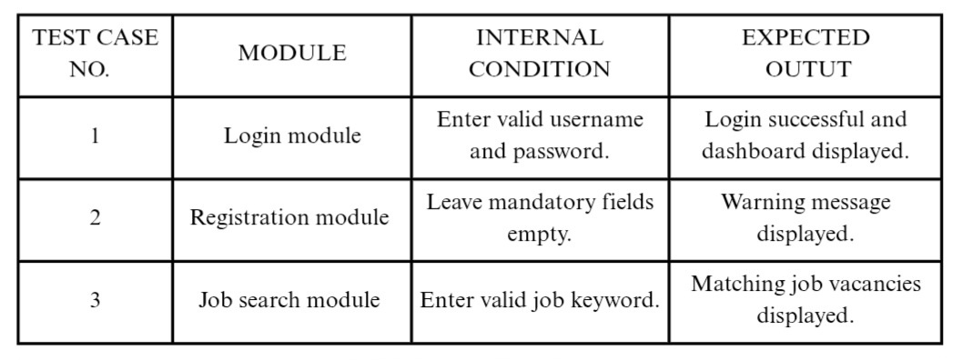
BLACK BOX TESTING

Slide 27
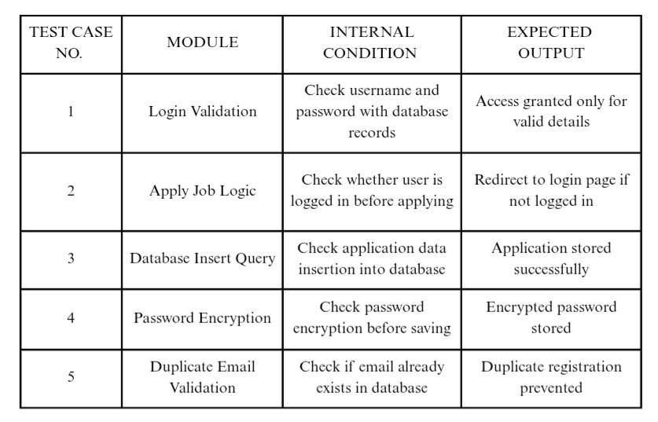
WHITE
BOX
TESTING

Slide 28
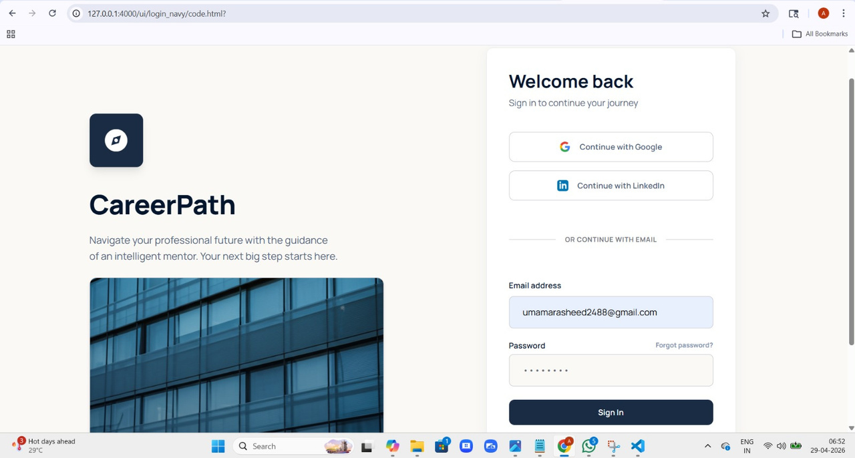
IMPLEMENTATION
  Input screen :

Slide 29
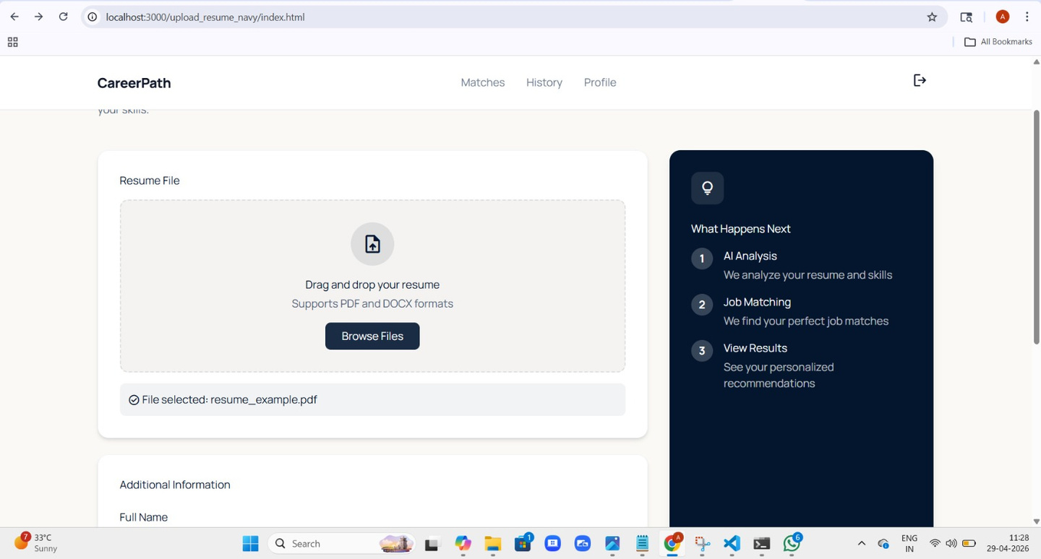

Slide 30
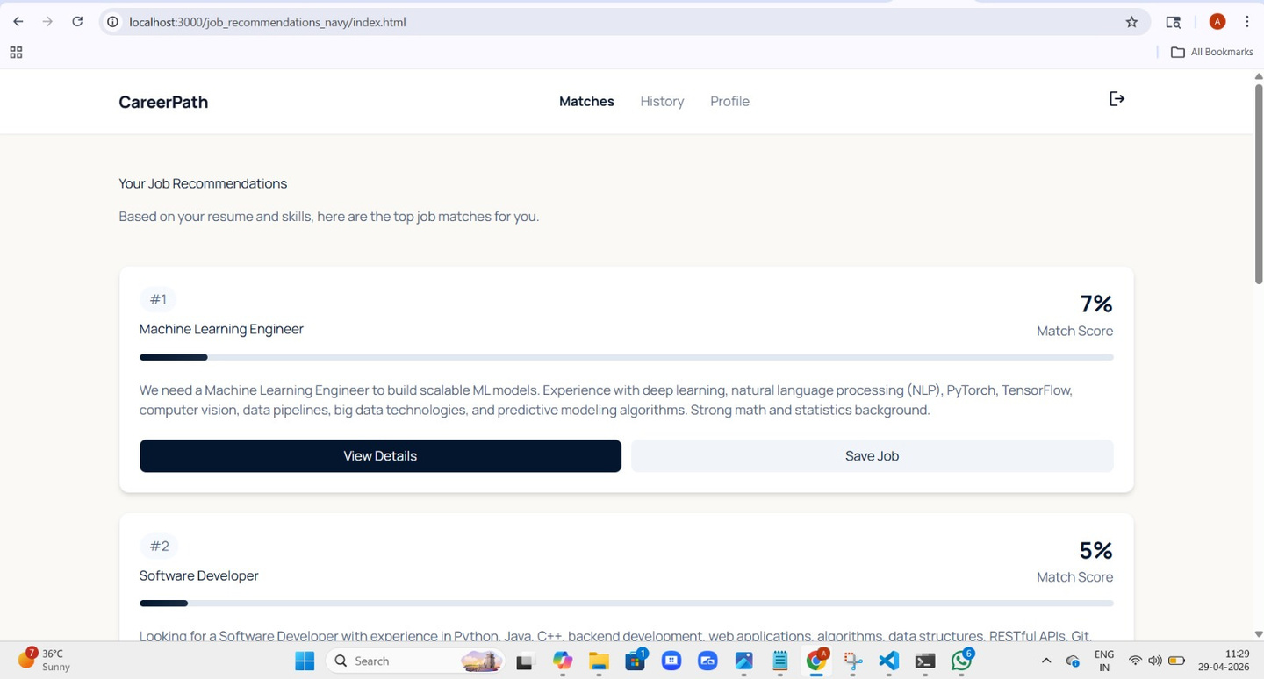
  Output screen :

Slide 31
CONCLUTION
The Job Portal System is a modern web-based application developed to simplify and improve the recruitment process for both job seekers and employers.
Overall, the project meets its objectives by providing an efficient online hiring solution. It is reliable, scalable, and easy to use, making it suitable for real-time implementation. The system creates better employment opportunities for candidates and helps organizations find qualified talent quickly and effectively.

Slide 32
FUTURE ENHANCEMENT
The Job Portal System can be further improved by adding advanced features and modern technologies to make it more intelligent, efficient, and user-friendly.
  Develop Android and iOS mobile applications.
  Implement automatic resume screening and candidate matching.
  Introduce online interview scheduling and video interviews.
  Add email, SMS, and push notification systems.
  Provide multi-language support for regional users.
  Add online aptitude, coding, and technical skill tests.
  Introduce AI chatbot for instant user support.
  Enable Google, LinkedIn, and social media login integration.
  Deploy system on cloud platforms for scalability and backup.

